Slide 1











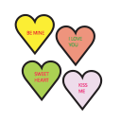






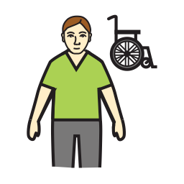




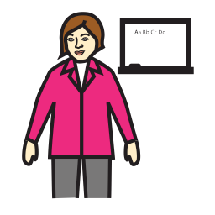





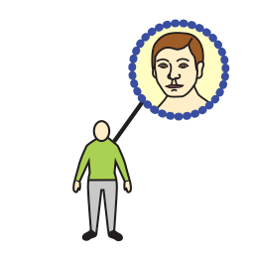
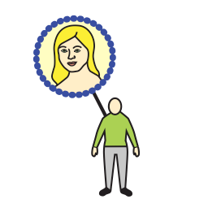





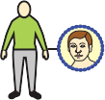
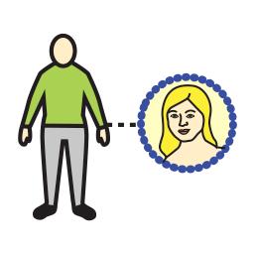







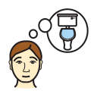
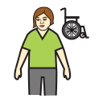


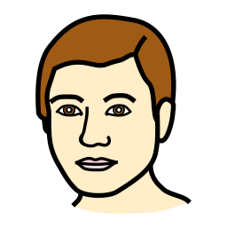














Yes | I like | hello | I want to talk to you | I’m fine | I’m not so good | cool
My name --------------- | I/me | you | get well soon | I love you | Happy Birthday | question ?
I live --------------- | Support staff | more | idea | different | same | feeling
My age | class/work | Ed staff | shape | colour | hot | cold
School/work | Dad | Mum | I want | go | call | eat
drink | brother | sister | have | watch | listen | do
food | family | friend | toilet | I need help | change | time
thing | man | woman | do hair | wash | pain | later
stuff | battery | tablet | camera | book | bag | furniture

Slide 2



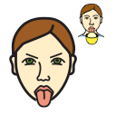
















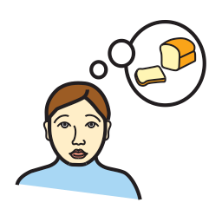
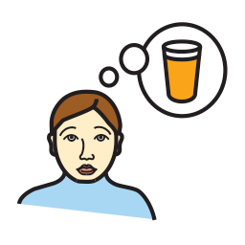










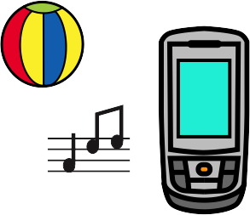















leave me alone | shut up | no symbol | goodbye | don’t like | No
Are ignoring me? | How are you? | when | why | where | don’t
afraid | sad | who | what | Can I….? | What’s your name?
bored | happy | hungry | thirsty | tired | How old are you?
drink | place | shop | outside | swimming | Where do you live?
tell | doctors | college | town | house | Your school/ work?
again | now | leisure | TV/DVD | body parts | animal
day | month | special day | phone | music | garden
things that help | clothes | transport | toiletries | nature | weather

